Slide 1
ExtentReports Version 5 for Cucumber 6 and TestNG
What is ExtentReport?
ExtentReport is a logger-style reporting library for automated tests. ExtentReports uses the logging style to add information about test sessions, such as the creation of tests, adding screenshots, assigning tags, and adding events or series of steps to sequentially indicate the flow of test steps. ExtentReports 5 is built on an open-Core.
That means, both community and professional editions use the same, full-featured API with the exception of a few reporters.
Extent Report 4 onwards, there are 2 editions of Extent Report – Core and Professional.
Generation of ExtentReport 5 in Cucumber6 with TestNG
Pre-Requisite:
Java 8 or higher is needed for ExtentReport5
Maven or Gradle
JAVA IDE (like Eclipse, IntelliJ, or soon)
TestNG installed
Cucumber Eclipse plugin (in case using Eclipse)

Slide 2
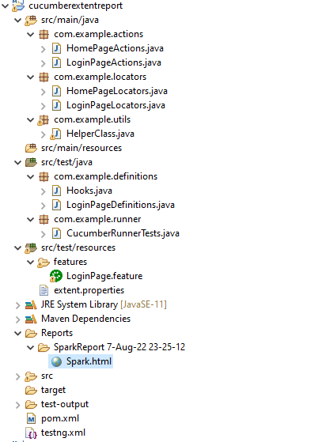
Project Structure

Slide 3
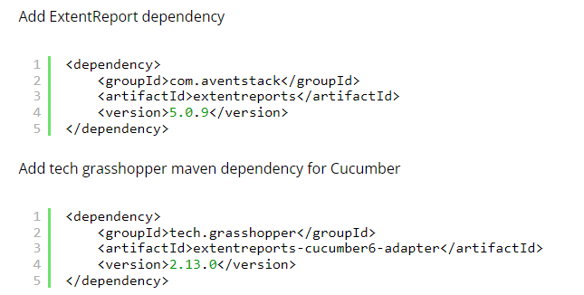
Step 1 – Add Maven dependencies to the POM
The complete POM.xml will look like as shown below with other Selenium and TestNG dependencies.

Slide 4
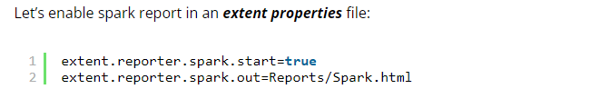
Step 2: Create a feature file in src/test/resources/
Step 3: Create extent.properties file in src/test/resources
We need to create the extent.properties file at the src/test/resources folder for the grasshopper extent report adapter to recognize it. Using a property file for reporting is quite helpful if you want to define several different properties.

Slide 5
Step 4: Create a Helper class in src/main/java
We have used Page Object Model with Cucumber and TestNG.
Create a Helper class where we are initializing the web driver, initializing the web driver wait, defining the timeouts, and creating a private constructor of the class, within it will declare the web driver, so whenever we create an object of this class, a new web browser is invoked. We are using a setter and getter method to get the object of Chrome driver with the help of a private constructor itself within the same class.
Step 5: Create Locator classes in src/main/java
Create a locator class for each page that contains the detail of the locators of all the web elements. Here,
I’m creating 2 locator classes – LoginPageLocators and HomePageLocators.
Step 6: Create Action classes in src/main/java
Create the action classes for each web page. These action classes contain all the methods needed by the step definitions. In this case, I have created 2 action classes – LoginPageActions and HomePageActions

Slide 6
Step 7: Create a Step Definition file in src/test/java
Create the corresponding Step Definition file of the feature file.
LoginPageDefinitions
Step 8: Create Hook class in src/test/java
Create the hook class that contains the Before and After hook. @Before hook contains the method to call the setup driver which will initialize the chrome driver. This will be run before any test.
After Hook – Here will call the tearDown method.
Step 9: Create a Cucumber Test Runner class in src/test/java
Add the extent report cucumber adapter to the runner class’s CucumberOption annotation. It is an important component of the configuration. It also ensures that the cucumber runner class recognizes and launches the extent report adapter for cucumber.

Slide 7
Step 10: Create the testng.xml for the project
Step 11: Execute the code
Step 12: View ExtentReport
Refresh the project and will see a new folder – Report. The ExtentReport will be present in that folder with the name Spark.html.
Right-click and open with Web Browser.
The report also has a summary section that displays the summary of the execution. The summary includes the overview of the pass/fail using a pictogram, start time, end time, and pass/fail details of features as shown in the image below.

Slide 8
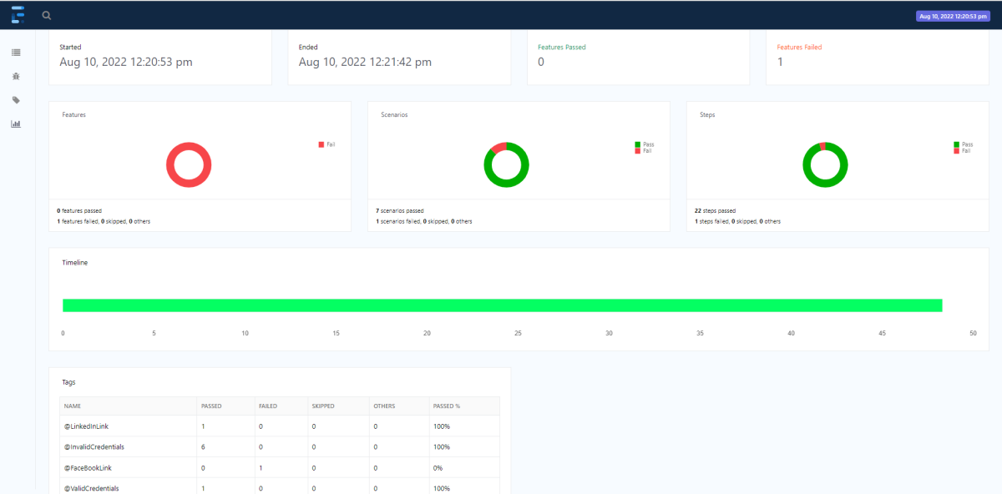

Slide 9
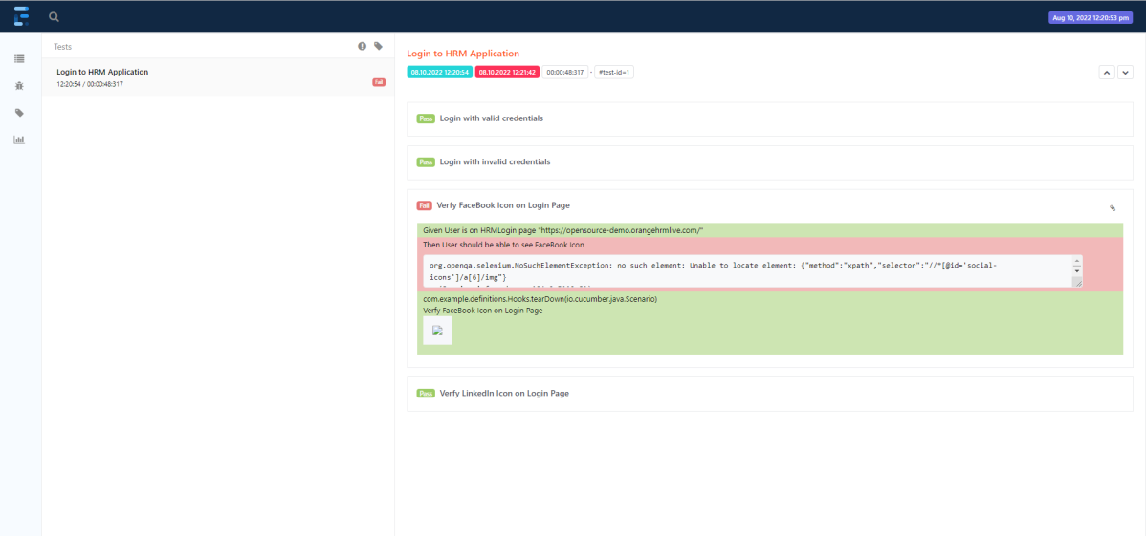
Click on the first icon present on the left side of the report. To view the details about the steps, click on the scenarios. Clicking on the scenario will expand, showing off the details of the steps of each scenario.

Slide 10
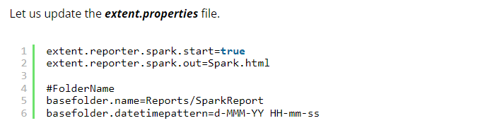
Step 13: How to customize the report folder name
We learned how to generate an ExtentReport in Cucumber Junit in the previous section. The problem with the previous approach is that it will continue to override the previous report once the new report is created. Typically, we must keep a backup of all the reports generated by previous tests. To accomplish this, we must save each report with a unique report name or folder name.
It’s simple to create reports with different folder names using the Extent reporter plugin adapter. Two settings must be added to our extent. basefolder.name and basefolder.datetimepattern are properties files. The values assigned to these will be combined to form a folder name. As a result, a report will be generated within that. The basefolder.datetimepattern value must be in a valid date-time format.

Slide 11
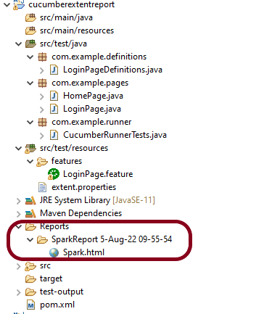
The value for basefolder.name in the preceding snippet is “Report/SparkReport.” It means that the folder will be named SparkReport, and that it will create a Report folder within the project directory. You can specify the location of your folder. In the following setting, we’ve used a date and time stamp to create unique folder names by concatenating them with the report name.
So, when we run the report, it will generate at the location shown in the image below:

